Slide 1


~Daily Health App~
By Aaron Novak

Slide 2
Welcome
App for every-one to use, easy to use.
Simple terminal app with main menu.
The skies the limit with future development.

Slide 3
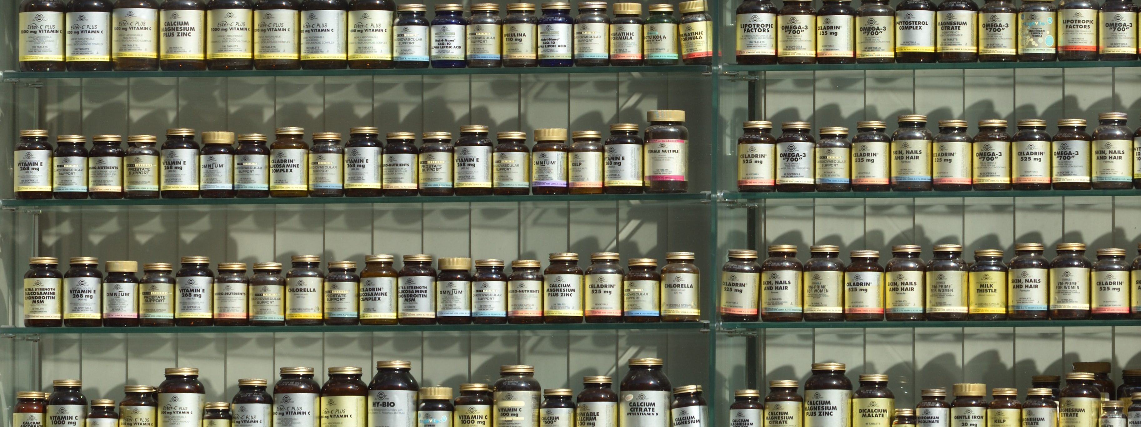
Digital Version of the Mon-Sun Pill box
Never forget to take your medication and vitamins etc again. You just log in and it will let you know!

Slide 4
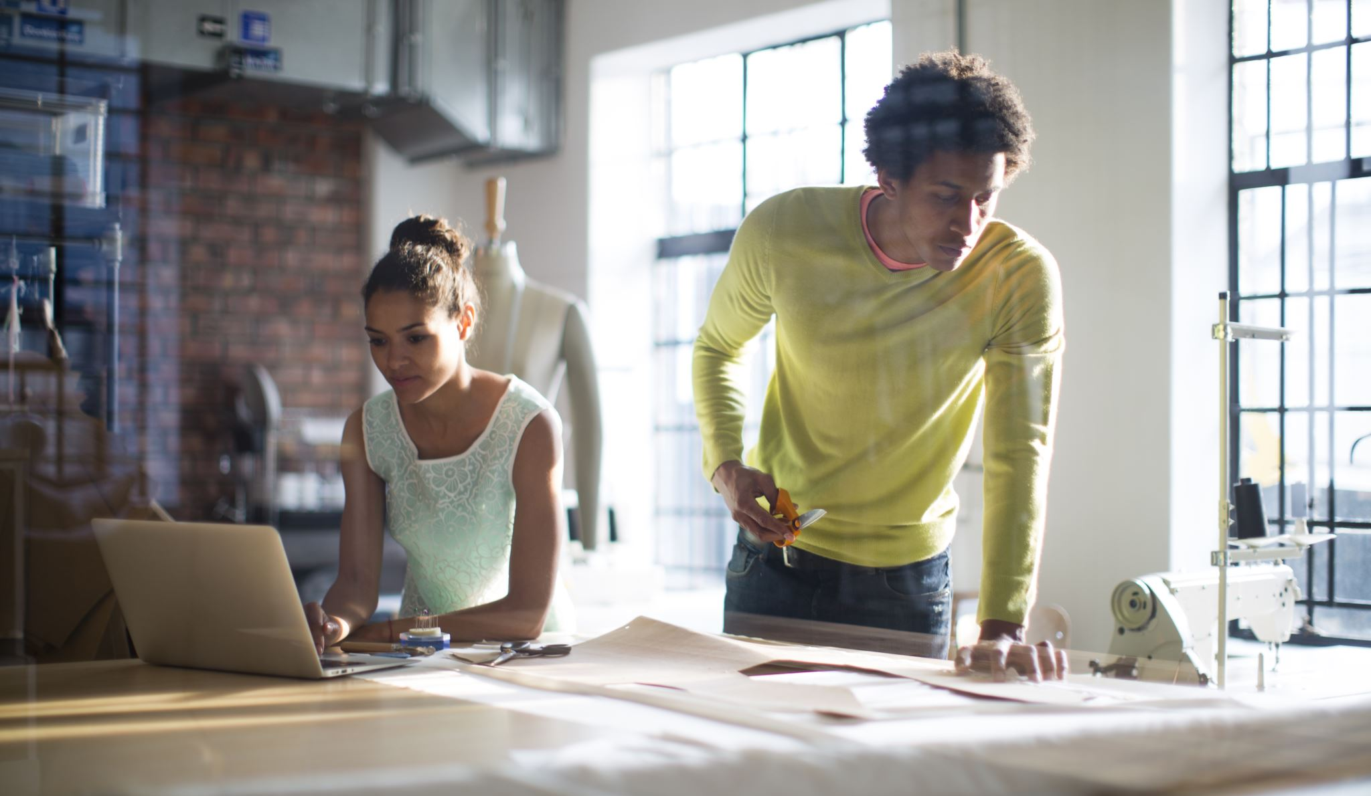
Fully customizable
You can add in anything you would like. If you want to do 10 star jumps twice a day, enter it in.
If you would like to eat 3 apples a day, enter away!

Slide 5
Add/delete/modify items
Add
Add your items
Add the amount of times you wish with said item
Delete
If you no longer need an item, delete it.
Modify or update an item.
Change the required amount of each item.
Modify

Slide 6

Various info
There is going to be a various info tab that you can go to:
- Quick Energy.
-Various Nootropics for studying.
-Stretches to make yourself feel more awake.
-Tones to help you sleep, study and relax.
-Breathing techniques.

Slide 7
Bonus information
Implement a small bit of info to get people thinking.
-Did you know fidgeting can burn up to 350 Calories a day?
-Splashing cold water on your face 3 times, wakes you up much faster!
- Studying and feel like no information is going in, try binaural beats.
-Heard of Nicotine? Yes, cigarettes, dive deeper. Its not as deadly as you think!
Knowledge = Power

Slide 8
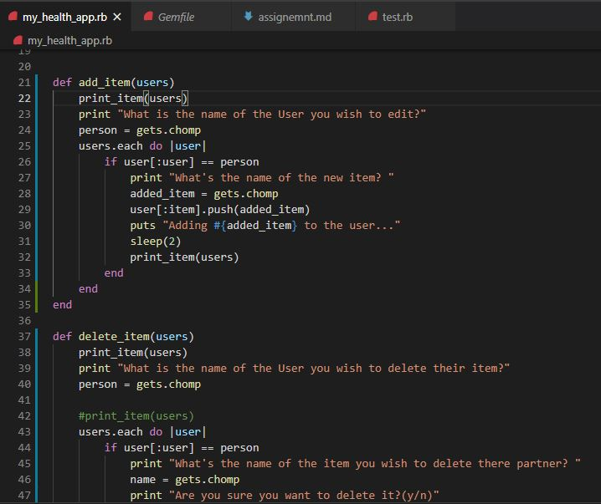
The code
Sneak
peak
of the
code.

Slide 9

Happy = Healthy
Basically, I just want to create an App so that all can use, and heavily benefit.
All the external bits apart from the actual add remove items part will be completely up to user discretion if they wish.

Slide 10

So the truth….
-That’s what it was meant to look like any way!
-I ran out of time and had to change to a much more basic layout – Doh!
-Here is the current working APP though, very scaled down.

Slide 11
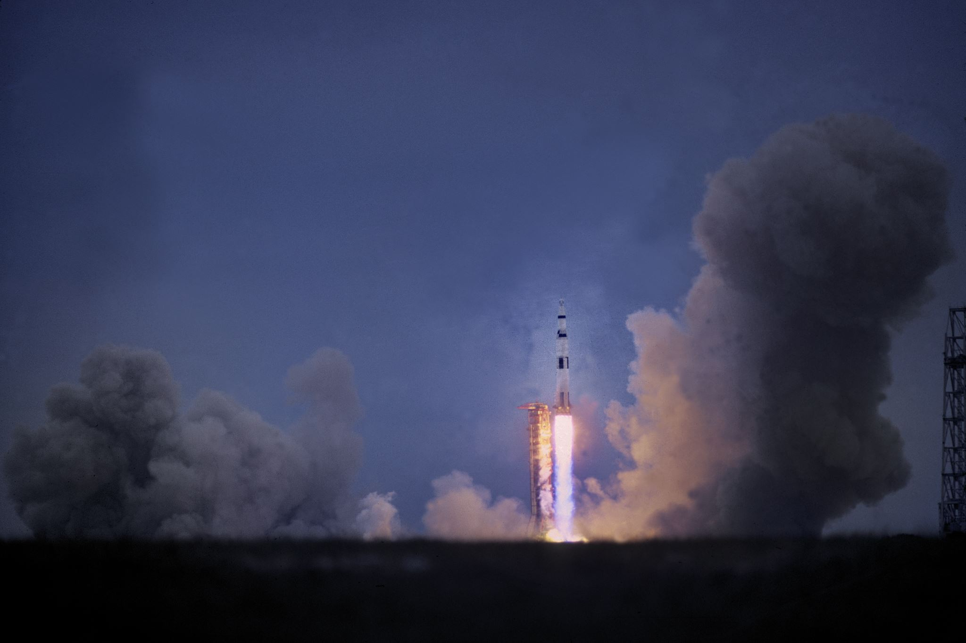
Future developments
-Add in mobile device with push notifications & alarms.
-All breathing techniques.
-Guided meditations.
-Reflexology.
-Essential oils & benefits.
-Detoxes, not only fasting and running to the toilet!
-Electrolytes and benefits even on non exercisers.

Slide 12
Special thanks to
Power-Point stock images.

Slide 13
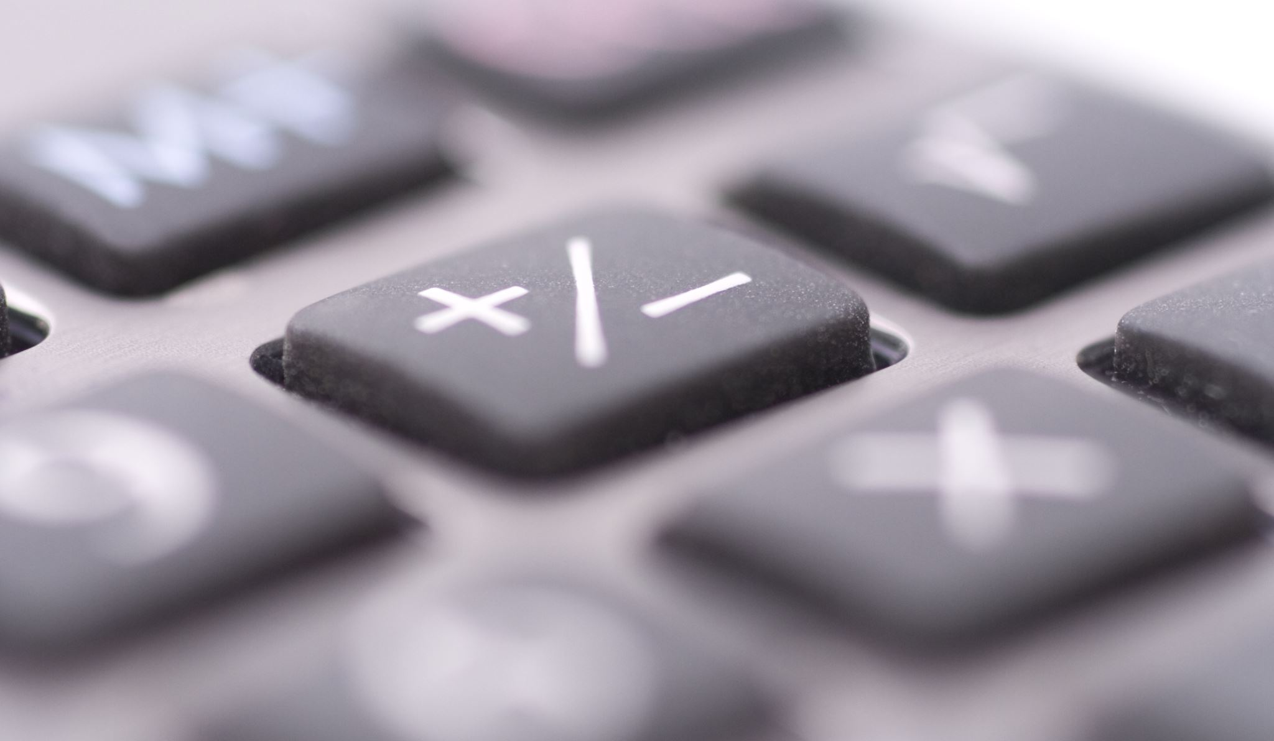

Thank you all for you’re time!

